Slide 1
Consumer Goods
Ad-Hoc Insights
Presented by : Ankit Kumar

Slide 2
OBJECTIVE
AtliQ Hardware, a global computer hardware manufacturer based in India, is enhancing its data analytics team to support informed decision-making.
The Director of Data Analytics, Tony Sharma, plans to conduct an SQL challenge to assess both technical skills and soft skills of potential junior data analysts.
The company has identified 10 specific ad hoc requests, reflecting real-world challenges, for candidates to provide valuable insights.
Acknowledging the critical role of data insights, AtliQ Hardware is strategically focusing on strengthening its data analytics capabilities.
As part of the initiative, the organization aims to bring in junior data analysts who can effectively address practical challenges in the field.

Slide 3
Data Understanding
This file provides a comprehensive overview for six main tables:
1. dim_customer: contains customer-related data
2. dim_product: contains product-related data
3. fact_gross_price: contains gross price information for each product
4. fact_manufacturing_cost: contains the cost incurred in the production of each
product
5. fact_pre_invoice_deductions: contains pre-invoice deductions information for each product
6. fact_sales_monthly: contains monthly sales data for each product.

Slide 4
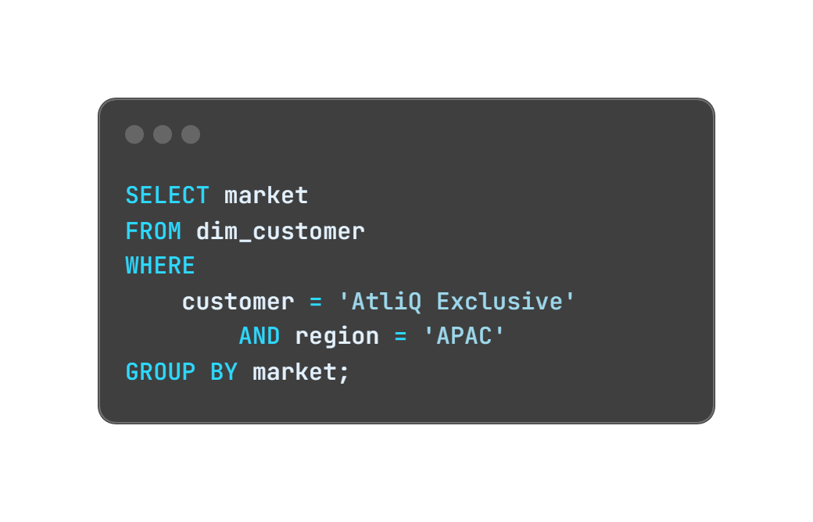
REQUEST 1
Provide the list of markets in which customer "AtliQ Exclusive" operates its business in the APAC region.
QUERY
OUTPUT

Slide 5
INSIGHTS
• AtliQ Exclusive has expanded its reach into eight primary markets across the APAC region.
• It reflects a robust market presence and
adaptability to different cultural and economic
contexts in the Asia-Pacific region.

Slide 6
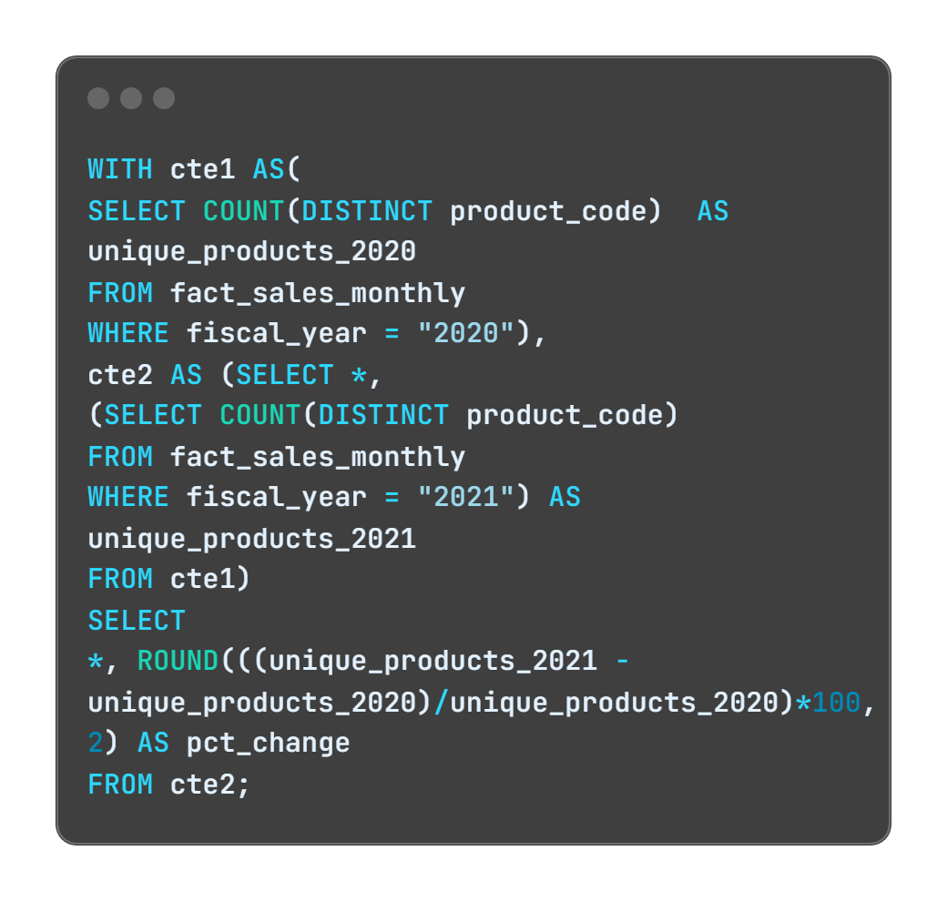
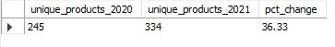
REQUEST 2
What is the percentage of unique product increase in 2021vs. 2020? The final output contains these fields, unique_products_2020, unique_products_2021 percentage_chg
QUERY
OUTPUT

Slide 7
INSIGHTS
During the fiscal year 2020, our product count stood at 245, and by FY 2021, it had risen to 334.
The percentage change represents a growth of 36.33% in unique products from one year to the next.

Slide 8
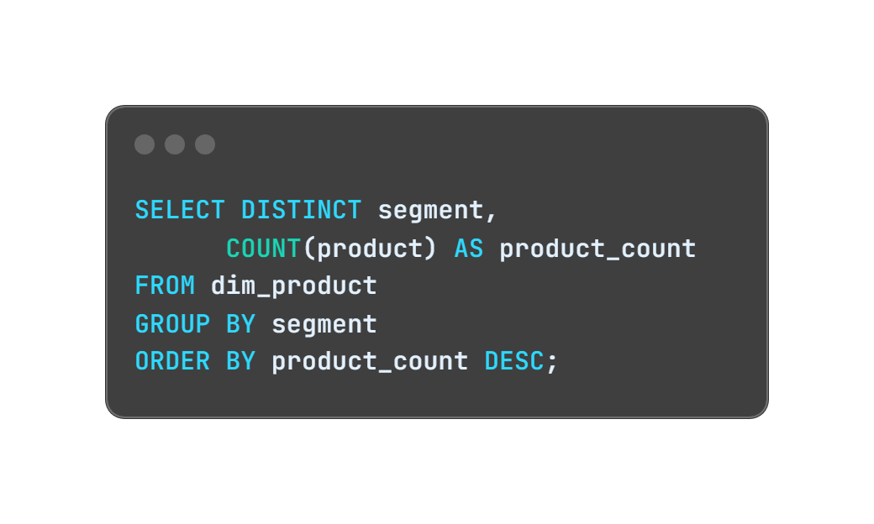
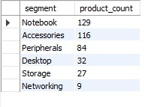
REQUEST 3
Provide a report with all the unique product counts for each segment and sort them in descending order of product counts. The final output contains 2 fields, segment & product_count
QUERY
OUTPUT

Slide 9
INSIGHTS
AtliQ Hardware offers a comprehensive range of products in the Notebook, Peripherals, and Accessories segments.
The "Notebook" segment has the highest product count, with 129 products.
The "Networking" segment has the smallest product count with only 9 products.
Recognizing the strategic imperative to diversify our product portfolio, we aim to expand into the desktop, networking, and storage markets.

Slide 10
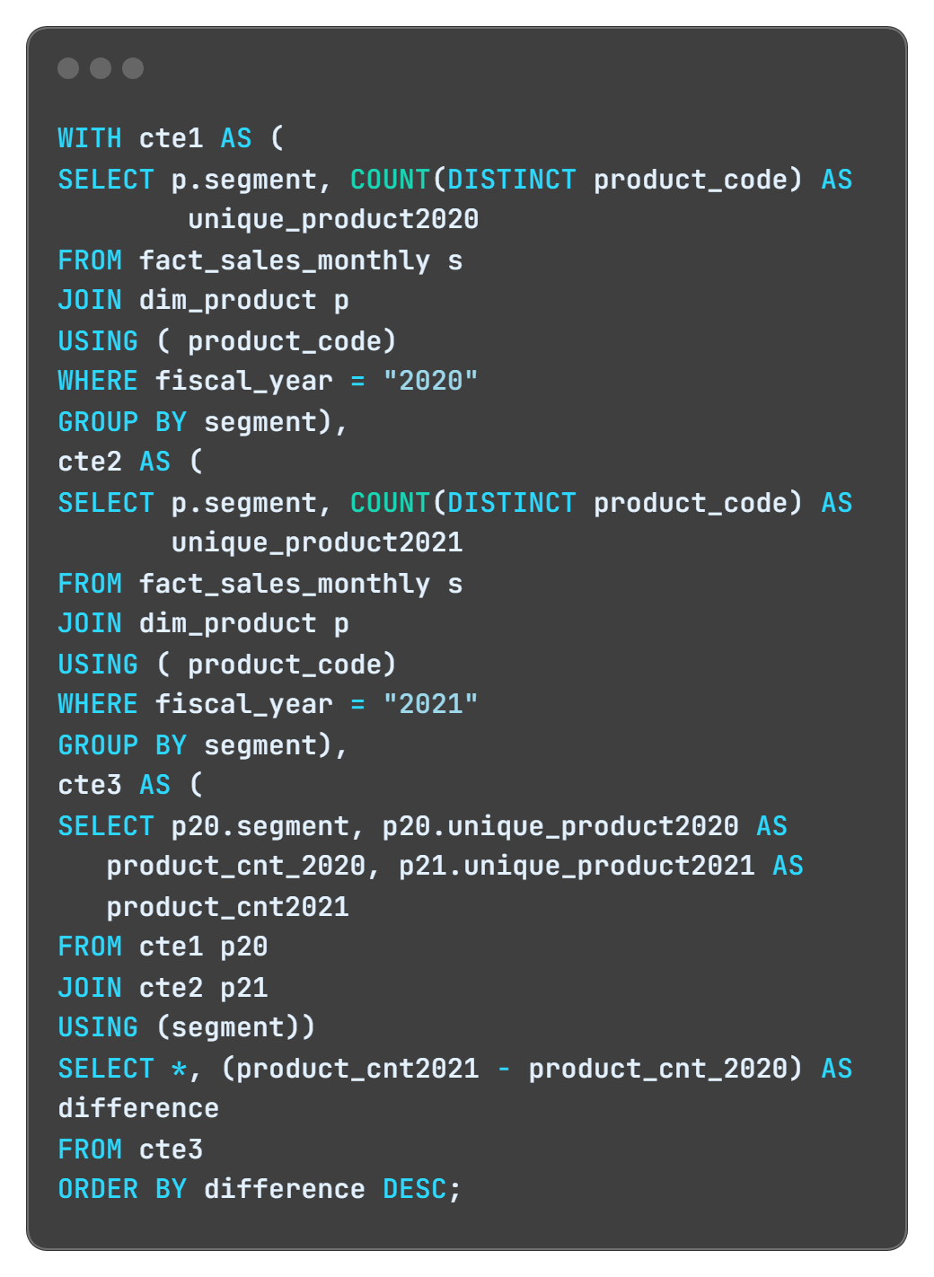
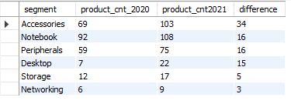
REQUEST 4
Follow-up: Which segment had the most increase in unique products in 2021 vs 2020? The final output contains these fields, segment product_count_2020, product_count_2021, difference.
QUERY
OUTPUT

Slide 11
INSIGHTS
In 2021, AtliQ Hardware placed a primary emphasis on extending its footprint in the accessories market, unveiling a total of 34 new accessory products.
These insights suggest a general trend of product portfolio growth, particularly in the "Accessories“ and "Notebook" segments, which can indicate a strategy to cater to a broader range of customer preferences.

Slide 12
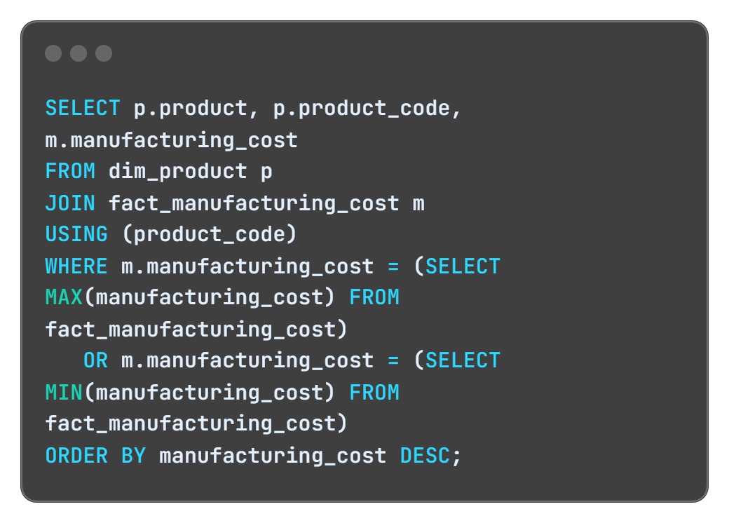
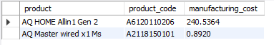
REQUEST 5
Get the products that have the highest and lowest manufacturing costs. The final output should contain these fields - product_code, product, manufacturing_cost
QUERY
OUTPUT

Slide 13
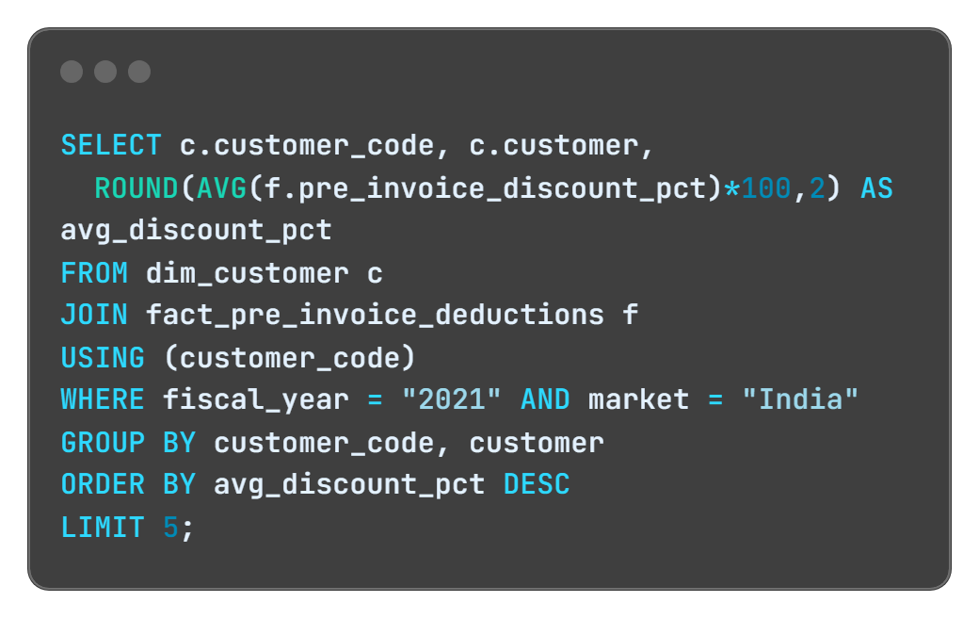
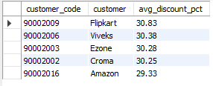
REQUEST 6
Generate a report which contains the top 5 customers who received an average high pre_invoice_discount_pct for the fiscal year 2021 and in the Indian market. The final output contains these fields- customer_code, customer, average_discount_percentage
QUERY
OUTPUT

Slide 14
INSIGHTS
Given that Flipkart maintains the status of being the most heavily discounted customer in the Indian market, boasting a pre-invoice discount percentage of 30.83%.
AtliQ applied approximately equivalent pre-invoice discount percentages to each of its top 5 clients in 2021.

Slide 15
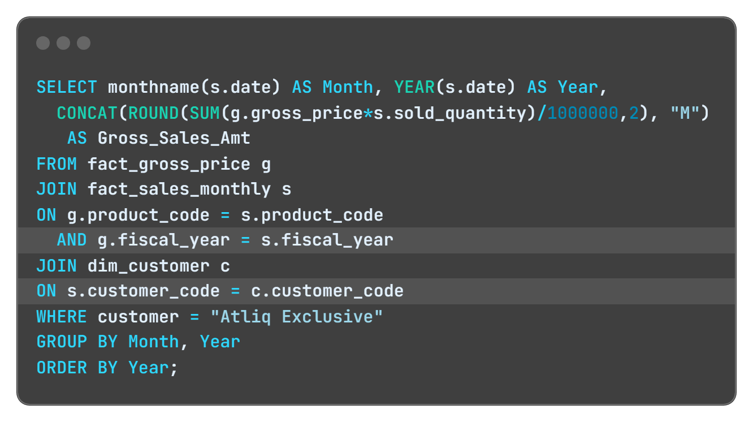
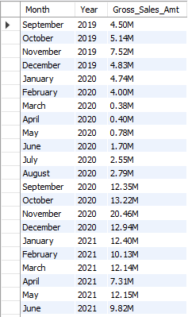
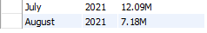
REQUEST 7
Get the complete report of the Gross sales amount for the customer “AtliQ Exclusive” for each month. This analysis helps to get an idea of low and high-performing months and take strategic decisions. The final report contains these columns: Month, Year, Gross sales Amount
QUERY
OUTPUT

Slide 16
INSIGHTS
AtliQ Exclusive achieved its peak sales in November 2020, with March 2020 marking the lowest point in sales.
The decrease in sales from March to August can be linked to the repercussions of COVID-19.
Nevertheless, there is a positive outlook as sales have steadily recovered post-pandemic, demonstrating resilience and surpassing the levels observed in 2020.

Slide 17
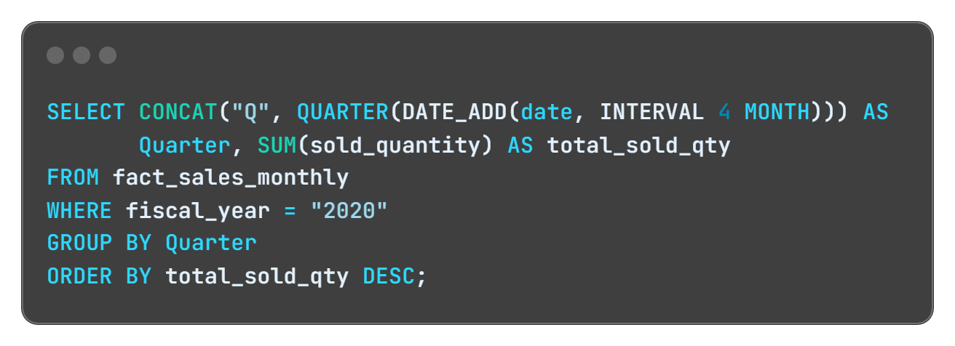
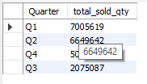
REQUEST 8
In which quarter of 2020, got the maximum total_sold_quantity? The final output contains these fields sorted by the total_sold_quantity, Quarter, total_sold_quantity
QUERY
OUTPUT

Slide 18
INSIGHTS
During the third quarter of fiscal year 2020 (March, April, and May), characterized by the peak of COVID-19 and extensive lockdowns affecting businesses, the quantity sold sharply declined to 2.1 million.
Interestingly, there was a notable surge in demand for computer accessories during this period, likely driven by a large number of students either beginning or continuing their coursework online.
This increased demand probably played a role in the early rebound observed in the fourth quarter.

Slide 19
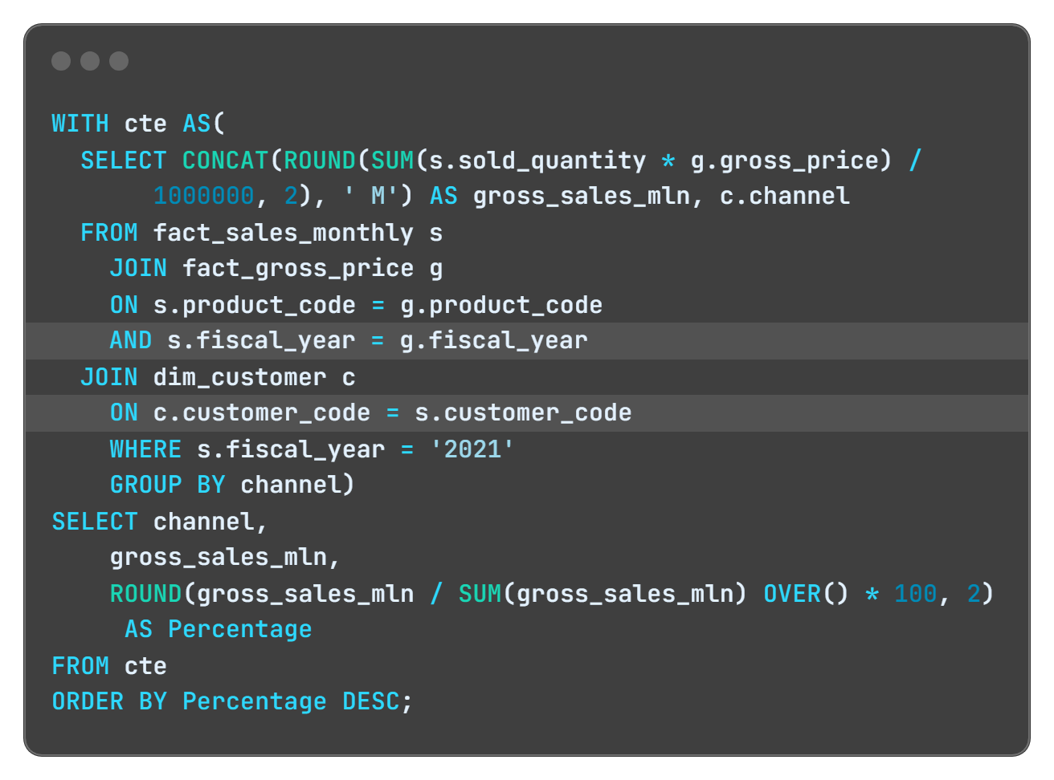
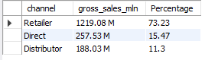
REQUEST 9
Which channel helped to bring more gross sales in the fiscal year 2021 and the percentage of contribution? The final output contains these fields – channel, gross_sales_mln, percentage
QUERY
OUTPUT

Slide 20
INSIGHTS
The "Retailer" channel accounts for the majority of sales, contributing to 73.22% of gross sales.
The "Direct" channel also plays a significant role,
representing 15.47% of gross sales.
The "Distributor" channel contributes 11.31% of gross sales.
A significant focus on the "Retailer" channel suggests it is the primary revenue driver.

Slide 21
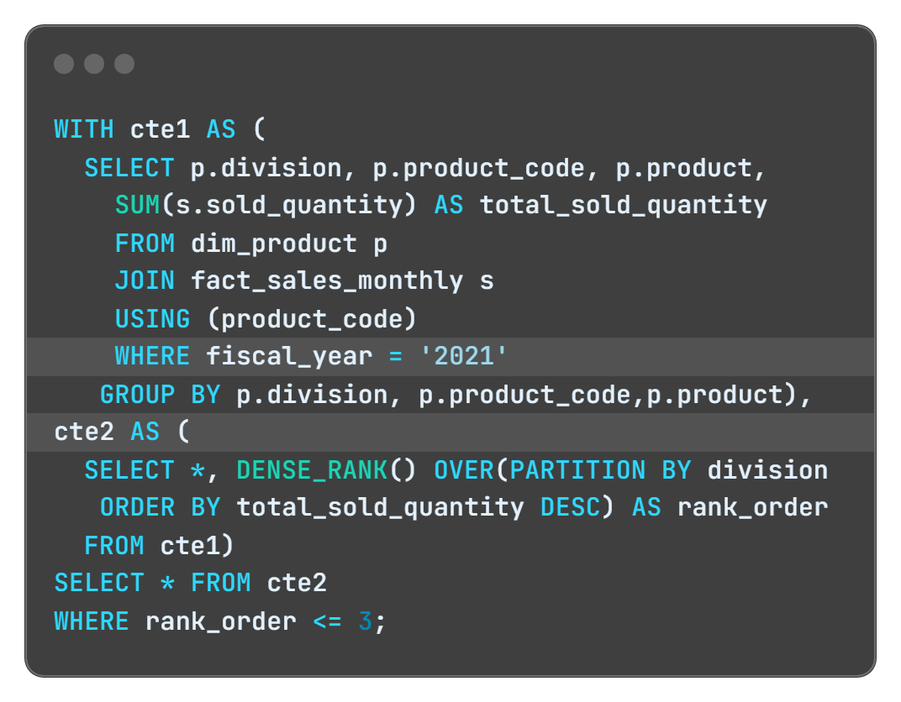
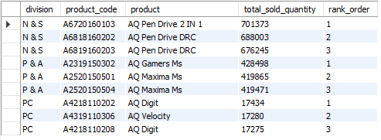
REQUEST 10
Get the Top 3 products in each division that have a high total_sold_quantity in the fiscal_year 2021?
The final output contains these fields - division, product_code
QUERY
OUTPUT

Slide 22
INSIGHTS
The three best-selling product in the N & S division were pen drivers. Strong consumer preference for pen drives and related items in this division.
The three best-selling product in the P & A division were pen mouse. This division specializes in gaming-related products, appealing to a specific customer niche..
The three best-selling product in the PC division were laptops. The division specializes in PC-related products, indicating a focus on the computing niche.

Slide 23
RECOMMENDATIONS FOR ENHANCING ATLIQ'S SALES PERFORMANCE
Ensure top-notch customer service to foster lasting relationships.
Deploy a robust marketing strategy across diverse channels.
Cultivate a distinctive brand identity and convey your unique value proposition.
Allocate resources to train the sales team for enhanced effectiveness.
Provide competitive pricing and appealing promotional offers.
Expand and improve product offerings to align with market demands.
Regularly collect customer feedback for continuous improvement.

Slide 24
THANK YOU
For Watching
Presented by : Ankit Kumar

